Slide 1


Slide 2
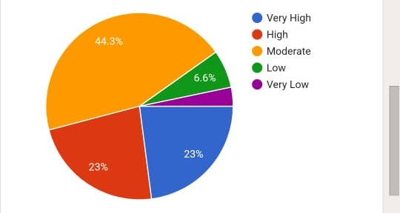
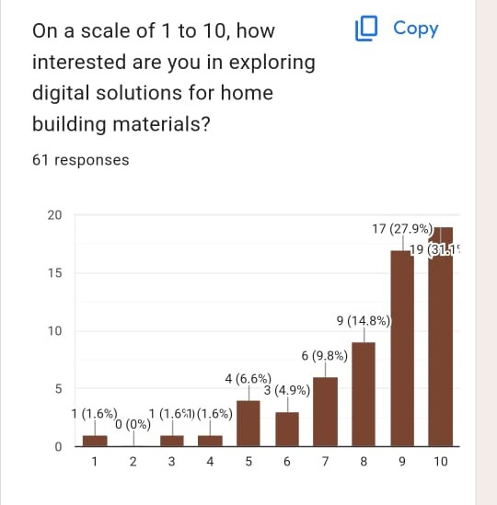
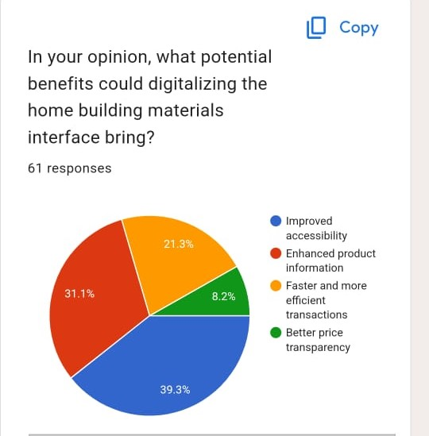
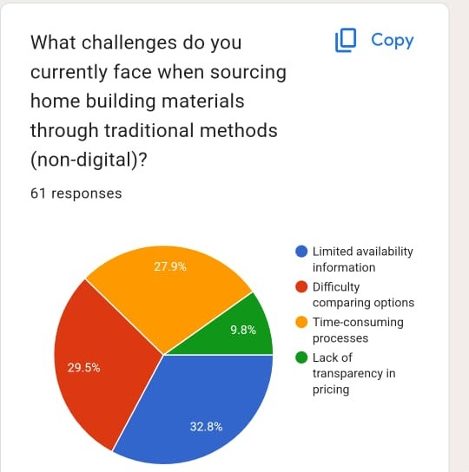

Slide 3
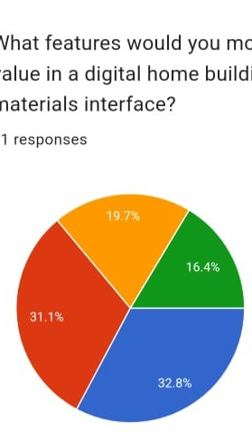
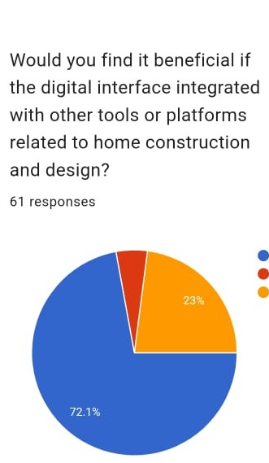
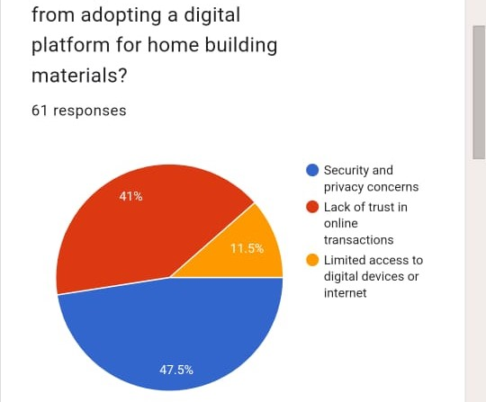
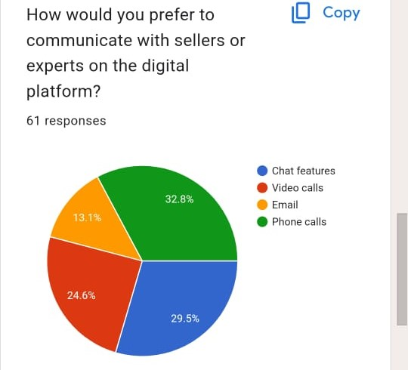

Slide 4
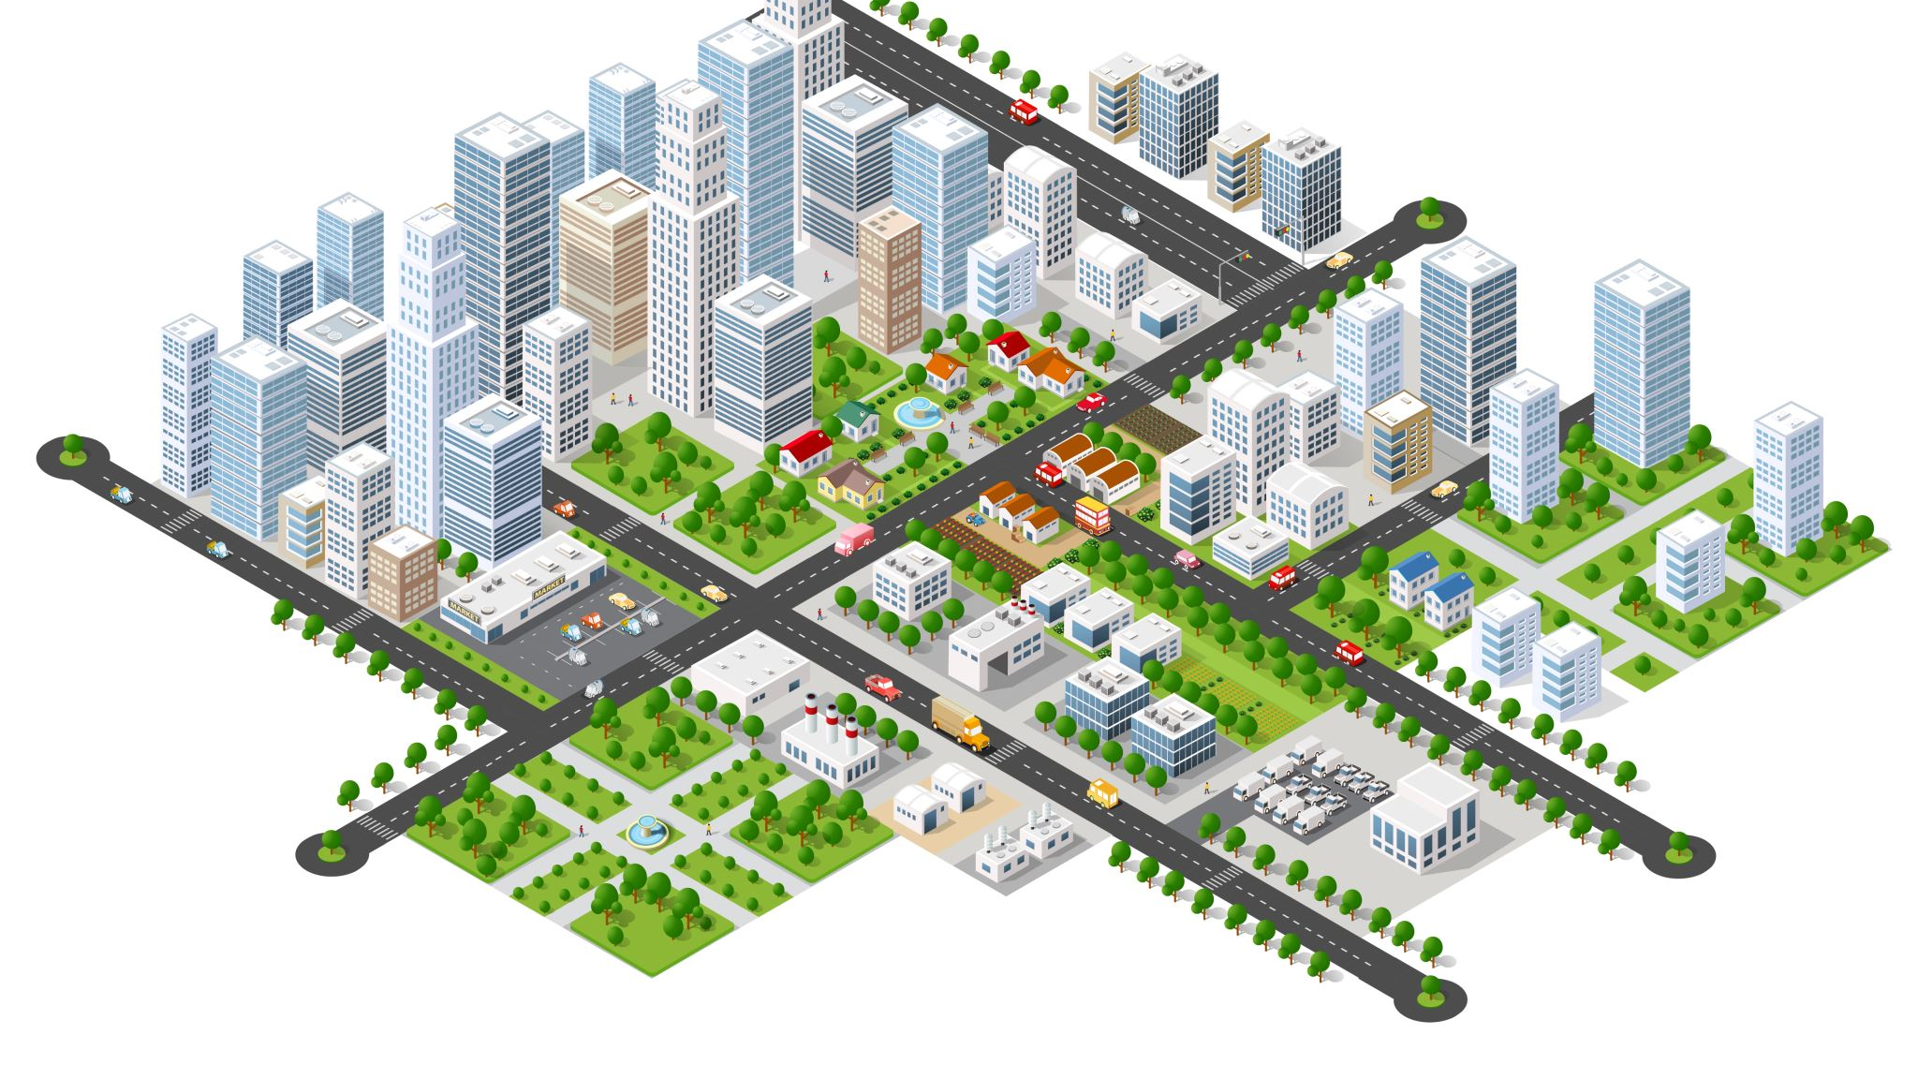
INTRODUCTION
The real estate sector is one of the most globally recognized sectors.
It comprises of four sub-sectors - housing, retail, hospitality, and commercial.
The growth of this sector is well complemented by the growth in the corporate environment and the demand for office space as well as urban and semi-urban accommodation.
The construction industry ranks third among the 14 major sectors in terms of direct, indirect and induced effects in all sectors of the economy.
In India, the real estate sector is the second-highest employment generator, after the agriculture sector..

Slide 5

Agenda
Primary goals
Report
Economic factors
Areas of growth
Timeline
Summary
conclusion

Slide 6

Primary goals
Coronavirus pandemic, there has been a major shift of the workforce towards tier 2 cities in India.
In these tier 2 cities, the cost of living is less, the work-life balance is better and housing remains affordable, as compared to mega cities in spite of a huge jump in values in the past one decade, backed by infrastructure development.
This has inspired Indian real estate developers, as well as state governments, to focus more on these tier 2 cities in India which are high-potential and yet, neglected markets.
Property prices rising but yet far lesser than top 10 cities.

Slide 7
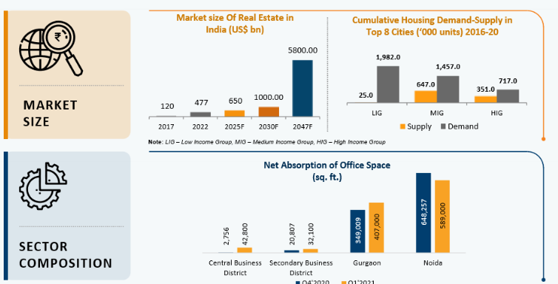
Real Estate Perfomance

Slide 8

Economic Factors
The construction industry is equally operational in all three economic sectors. The procurement of natural resources falls in the primary sector, manufacturing building components in the secondary and the tertiary sector includes the many consultation services it offers.
While the process of construction officially begins at excavation, the preceding steps are taken in advance, requiring both time and capital. Recessions in the economy can often sink prices of properties.
The prices of building materials, equipment and labour are likely to follow the downward trend in such a scenario and balance the construction costs. Hence, the ability to absorb certain fluctuations in the economy makes the construction industry relatively steady on the overall front.
The government policies can leverage the construction industry to stabilise employment in a volatile market by boosting labour creation during low-demand spells. Similarly, in times of market saturation, large-scale projects may be postponed to maintain the balance

Slide 9
Plan for launch
Deploy strategic networks with compelling e-business needs
Planning
Synergize scalable e-commerce
Marketing
Disseminate standardized metrics
Design
Coordinate
Foster holistically superior methodologies
Launch
Strategy
e-business applications
1
2
3
4
5
https://homematerials.in/

Slide 11
Milestones
Implementing the startup
01-02-2024
10-02-2024
Designing the user interface
01-03-2024
Integrating the WhatsApp,GPS and payment modules to the website. 4
20-03-2024
Tie-up with the vendors
15-04-2024
Research and survey of the project
11

Slide 12
Areas of focus
B2B market scenarios
Cloud-based opportunities
Key trends include increased demand for eco-friendly materials, digitalization of procurement processes, and a focus on supply chain resilience
we provide a wide range of construction material and we are hear to supply material all over hyderabad and we more less price from our vendors so that we can target and attract customers easily and in early process
leveraging cloud data of users can offer numerous advantages. This data can include preferences, purchase history, browsing behavior, and more.
analyzing this data, companies can personalize the user experience for best

Slide 13
How we get there
Follow markets trends
SCOPE
Supply chains
User-friendly design
Easy navigation
Comprehensive product listings
Secure payment options
Quick delivery
Pursue scalable customer service through sustainable strategies
Engage top-line web services with cutting-edge deliverables
Cultivate one-to-one customer service with robust ideas
Maximize timely deliverables for real-time schemas

Slide 14
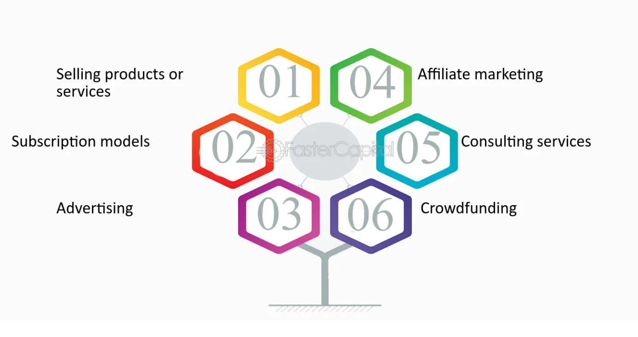
four Ps are product, price, place, and promotion

Slide 15



Slide 16
CONCLUSION
A reliable and timely supply of high-quality construction materials is crucial for the success of any home building project. Ensuring a consistent flow of materials not only accelerates the construction process but also contributes to the overall efficiency, cost-effectiveness, and successful completion of the project. Clear communication, strategic sourcing, and collaboration with reputable suppliers are key factors in maintaining a smooth supply chain for home building construction.

Slide 17

Thank you
Mirjam Nilsson​
mirjam@contoso.com
www.contoso.com

